Slide 1
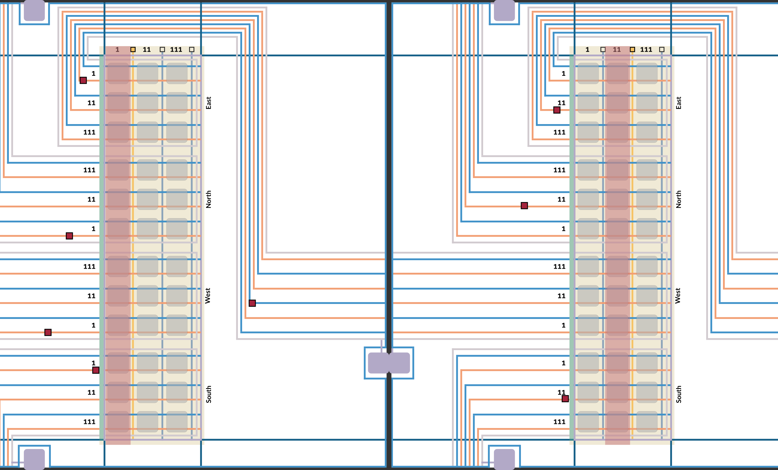
Intrinsic Universality in Seeded Active Tile Self-Assembly
Timothy Gomez², Elise Grizzell¹, Asher Haun¹, Ryan Knobel¹, Tom Peters³, Robert Schweller¹, Tim Wylie¹
1 University of Texas Rio Grande Valley, 2 Massachusetts Institute of Technology, 3 TU Eindoven
Notes:
In the main result of my thesis focuses on the creation of a Universal Tile Set in the Seeded Tile Automata model

Slide 2

Seeded TA
Tiles:
System:
A
A
B
C
B
A
Affinities:
A
A
Temperature: $τ$
C
B
B
B
A
B
B
B
A
C
B
C
A

Slide 3
Seeded TA
Tiles:
System:
A
A
B
C
B
A
Affinities:
A
A
Temperature: $τ$
C
B
B
B
A
B
B
C
B
A
C
B
A

Slide 4
Seeded TA
Tiles:
System:
A
A
B
C
B
A
Affinities:
A
A
Temperature: $τ$
B
B
B
A
B
B
C
C
B
A
C
B
A

Slide 5
Seeded TA
Tiles:
System:
A
A
B
C
B
A
Affinities:
A
A
B
Temperature: $τ$
B
B
A
B
B
C
C
B
A
C
B
A

Slide 6
Seeded TA
Tiles:
System:
A
A
B
C
B
A
Affinities:
A
A
B
Temperature: $τ$
B
B
A
A
B
B
C
C
B
A
C
B

Slide 7
Seeded TA
Tiles:
System:
A
B
C
B
A
Affinities:
A
A
B
A
Temperature: $τ$
B
B
A
A
B
B
C
C
B
A
C
B

Slide 8
Seeded TA
Tiles:
System:
A
B
C
A
Affinities:
A
A
B
A
Temperature: $τ$
B
B
A
B
A
B
B
C
C
B
A
C
B

Slide 9

Seeded TA
Transitions:
System:
A
B
C
C
A
Affinities:
A
A
B
A
Temperature: $τ$
B
B
A
B
A
B
B
C
C
B
A
C
B

Slide 10
Seeded TA
Transitions:
System:
A
B
C
C
A
Affinities:
A
C
C
A
Temperature: $τ$
B
B
A
B
A
B
B
C
C
B
A
C
B

Slide 11
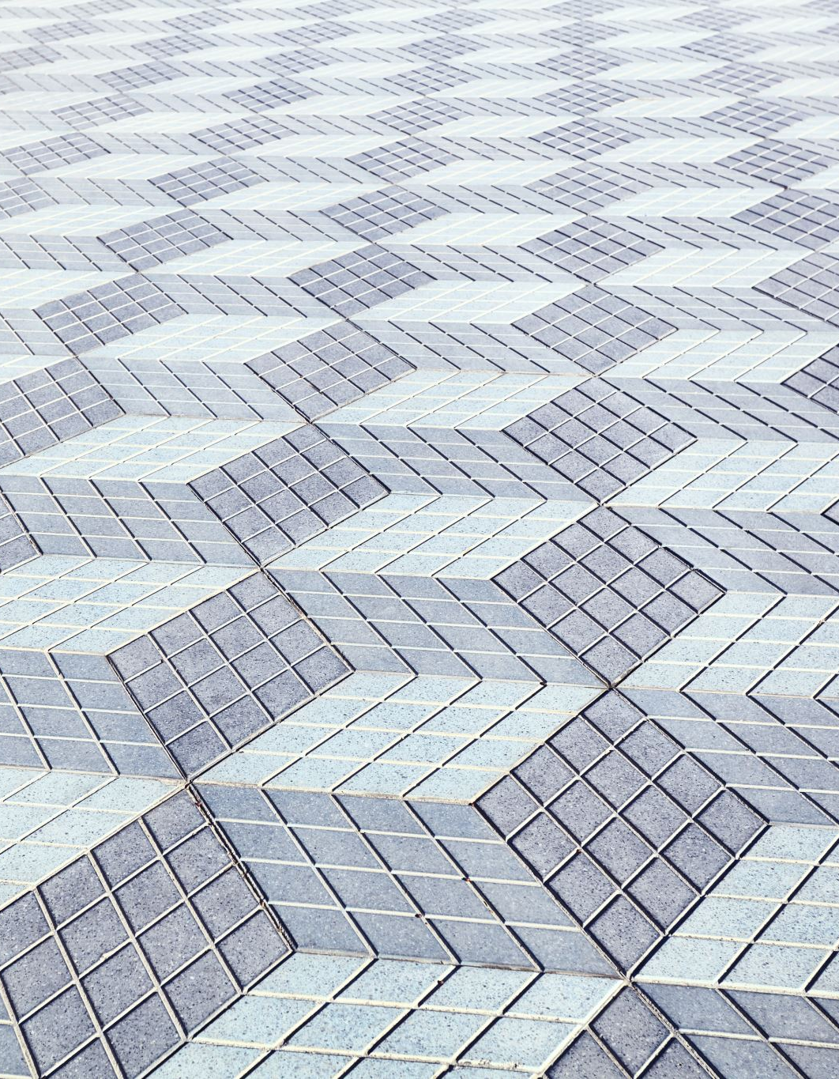
Intrinsic Universality in Self-Assembly
An Intrinsically Universal Tile Set can be programmed to copy not only the shape(s) built by another system but also the dynamics of how the tile set we are simulating builds. This means it can build anything any other tile set can build in the same way.
A class of tile assembly systems C is said to be intrinsically universal if there exists a single set of tiles U that simulates any instance of C.
The entire tile assembly system T is itself encoded in the seed supertile(s) of U.

Slide 12
Scale-1 vs Scale-m
S
A
B
S
A
S
A
S
C
S
A
S
S
B
C
B
B
C
S
A
B

Slide 13
Scale-1 vs Scale-m
Mapping
S
A
B
S
S
A
S
A
S
C
S
A
A
S
S
B
C
B
B
B
C
C
S
A
B

Slide 14
Scale-1 vs Scale-m
Mapping
S
A
B
C

Slide 15
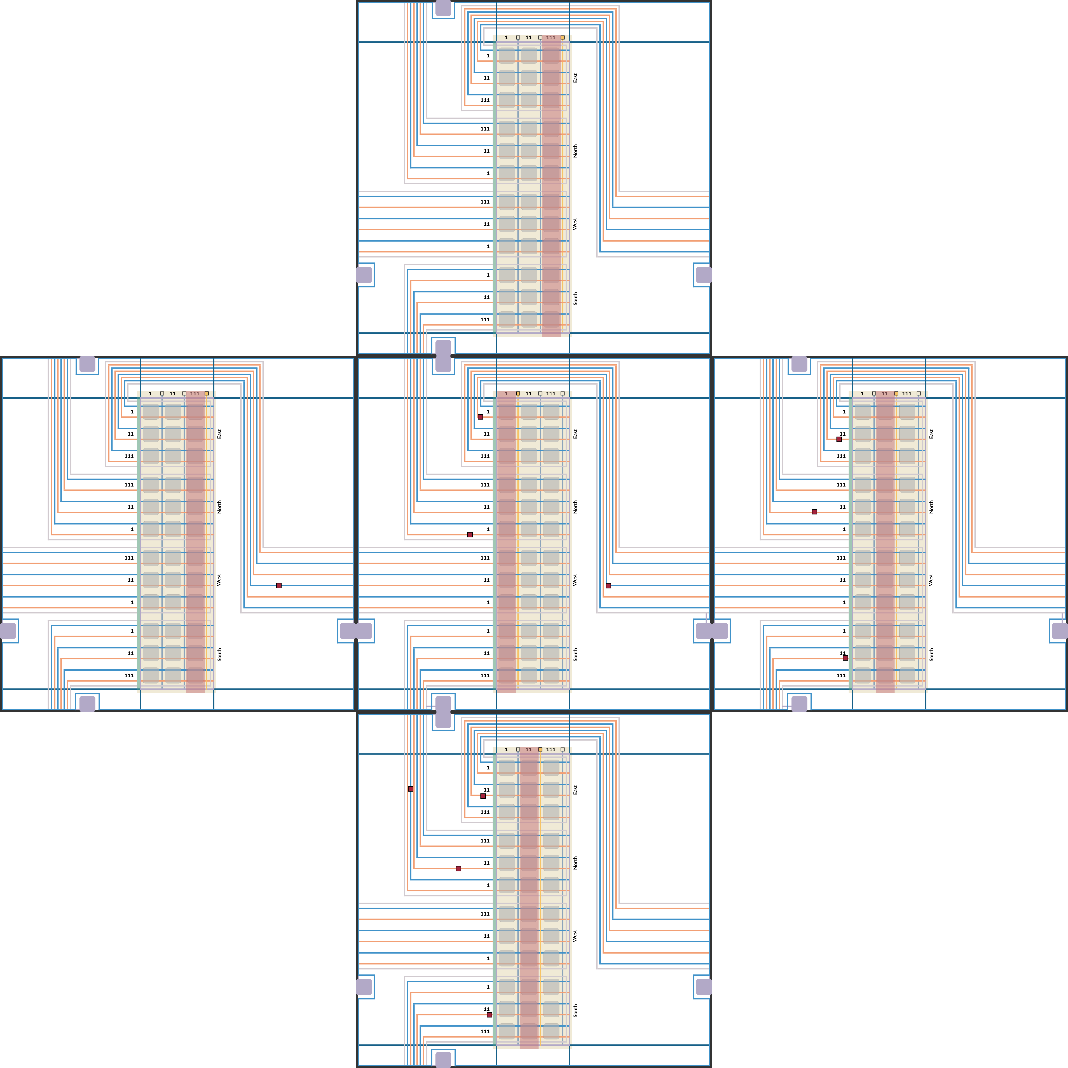
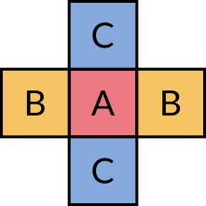

Slide 16
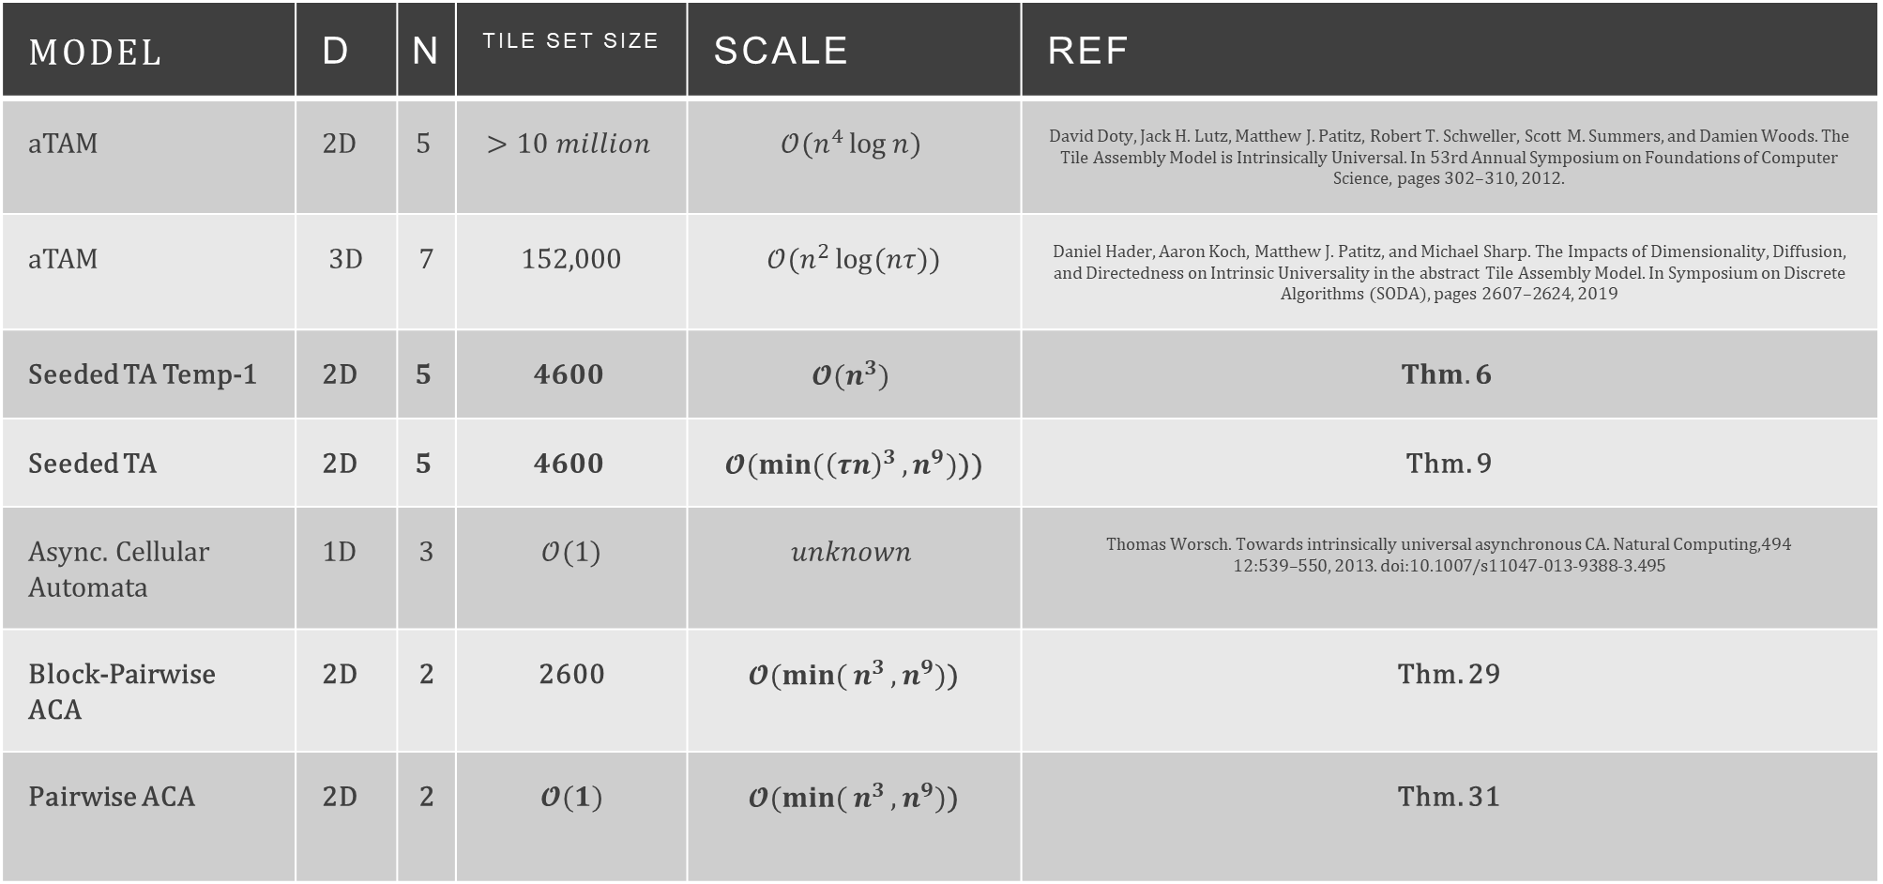
Our Results and Previous Work
Model | D | N | Tile Set Size | Scale | Ref
aTAM | 2D | $$5$$ | $$>10 million$$ | $$𝒪(n^{4}\log{n})$$ | David Doty, Jack H. Lutz, Matthew J. Patitz, Robert T. Schweller, Scott M. Summers, and Damien Woods. The Tile Assembly Model is Intrinsically Universal. In 53rd Annual Symposium on Foundations of Computer Science, pages 302–310, 2012.
aTAM | 3D | 7 | 152,000 | $𝒪(n^{2}\log{(nτ})$) | Daniel Hader, Aaron Koch, Matthew J. Patitz, and Michael Sharp. The Impacts of Dimensionality, Diffusion, and Directedness on Intrinsic Universality in the abstract Tile Assembly Model. In Symposium on Discrete Algorithms (SODA), pages 2607–2624, 2019
Seeded TA Temp-1 | 2D | $$5$$ | $$4600$$ | $$𝓞(n^{3})$$ | $$Thm. 6$$
Seeded TA | 2D | $$5$$ | $$4600$$ | $𝓞({min(\left(τn\right)}^{3}, n^{9})$)) | Thm. 9
Async. Cellular Automata | 1D | 3 | $$𝒪(1)$$ | $$unknown$$ | Thomas Worsch. Towards intrinsically universal asynchronous CA. Natural Computing,494 12:539–550, 2013. doi:10.1007/s11047-013-9388-3.495
Block-Pairwise ACA | 2D | 2 | 2600 | $𝓞({min({n}}^{3}, n^{9})$) | Thm. 29
Pairwise ACA | 2D | 2 | $$𝓞(1)$$ | $𝓞({min({n}}^{3}, n^{9})$) | Thm. 31
Notes:
Cellular Automata. For the originator of the concept of intrinsic universality, the study of81 self-simulation and new types of universalities is as old as the field of Cellular Automata itself,82 with von Neumann introducing the model to build a self-replicating machine [ 21]. Though it83 was Banks in 1970 who explicitly coined the term intrinsic universality [ 2 ], von Neumanns84 initial construction was later proven to be intrinsically universal. Conway’s famous Game of85 Life cellular automaton was proven to be intrinsically universal [10 ]. Intrinsic universality in86 CA has been extensively studied.
Abstract Tile Assembly Model. Intrinsic universality first crossed into the self-assembly88 world in where a universal tile set was introduced for systems with tiles that bond with89 exactly strength 2. Two years later, the first properly intrinsically universal tile set, one that90 can simulate the full aTAM at any temperature, was presented in [ 8 ]. It was also shown91 that a single polygon tile type with the ability to flip, translate, and rotate can simulate92 any aTAM system through several intermediate simulations [6]. The aTAM was found not93 to be intrinsically universal at Temperature-1 [ 20 ], and in directed and non-directed planar94 systems [13]. Directed 3D and Spacial aTAM were proven to be IU [ 13 ]. The 2-handed95 self-assembly model is, in general, not intrinsically universal; however, there are intrinsically96 universal tile sets for each temperature [ 7]. Work towards a universal tile set in Wang Tiles,97 which studies whether a given tile set can infinitely, and potentially periodically, tile a plane,98 has also been investigated.
Intrinsic Universality has also been studied in Automata Networks, Turado Heirarchies, and General Computation

Slide 17
Gadgets
c

Slide 18
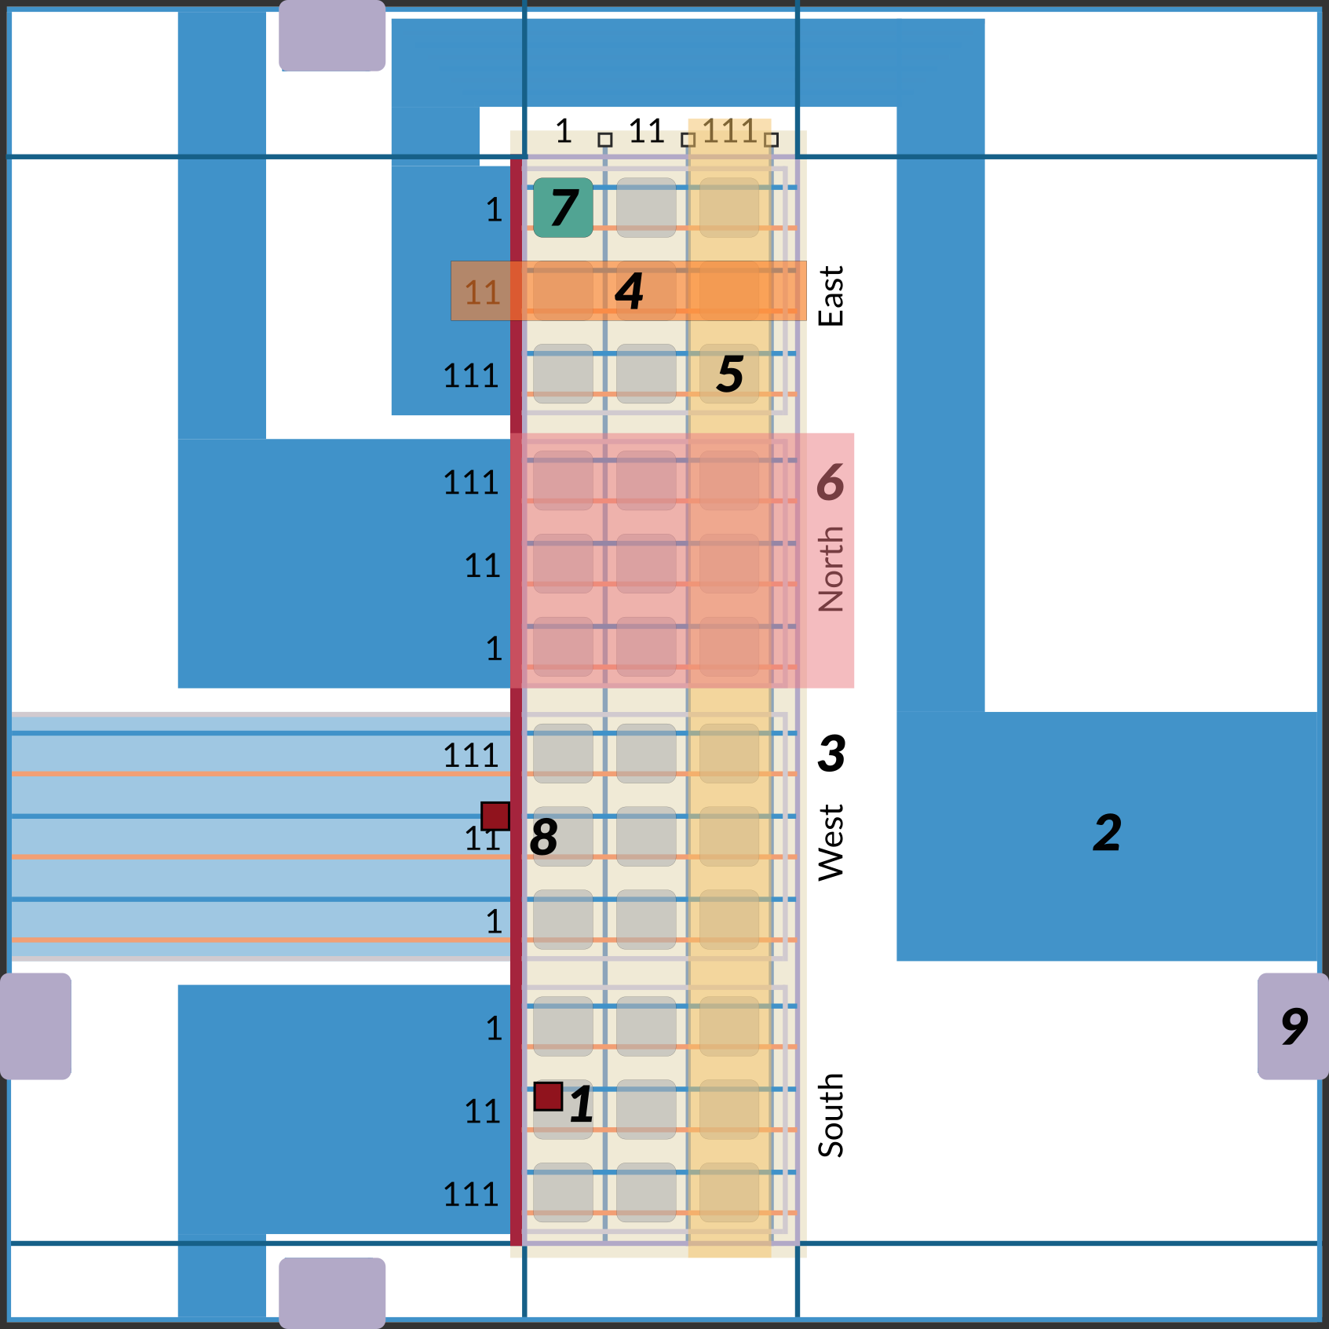
The Supertile
Notes:
Agents
Wires
The Table
Rows
Columns
Subtable
Datacell
Table control edge
Transition Selection Gadget

Slide 19
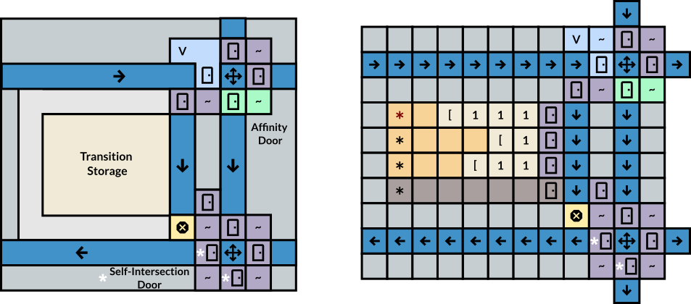
The Datacell

Slide 20
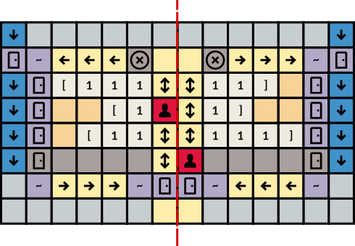
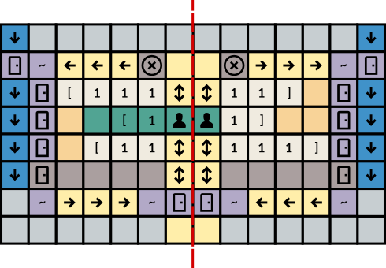
Transition Selection Gadget

Slide 21
Transitioning Supertiles

Slide 22
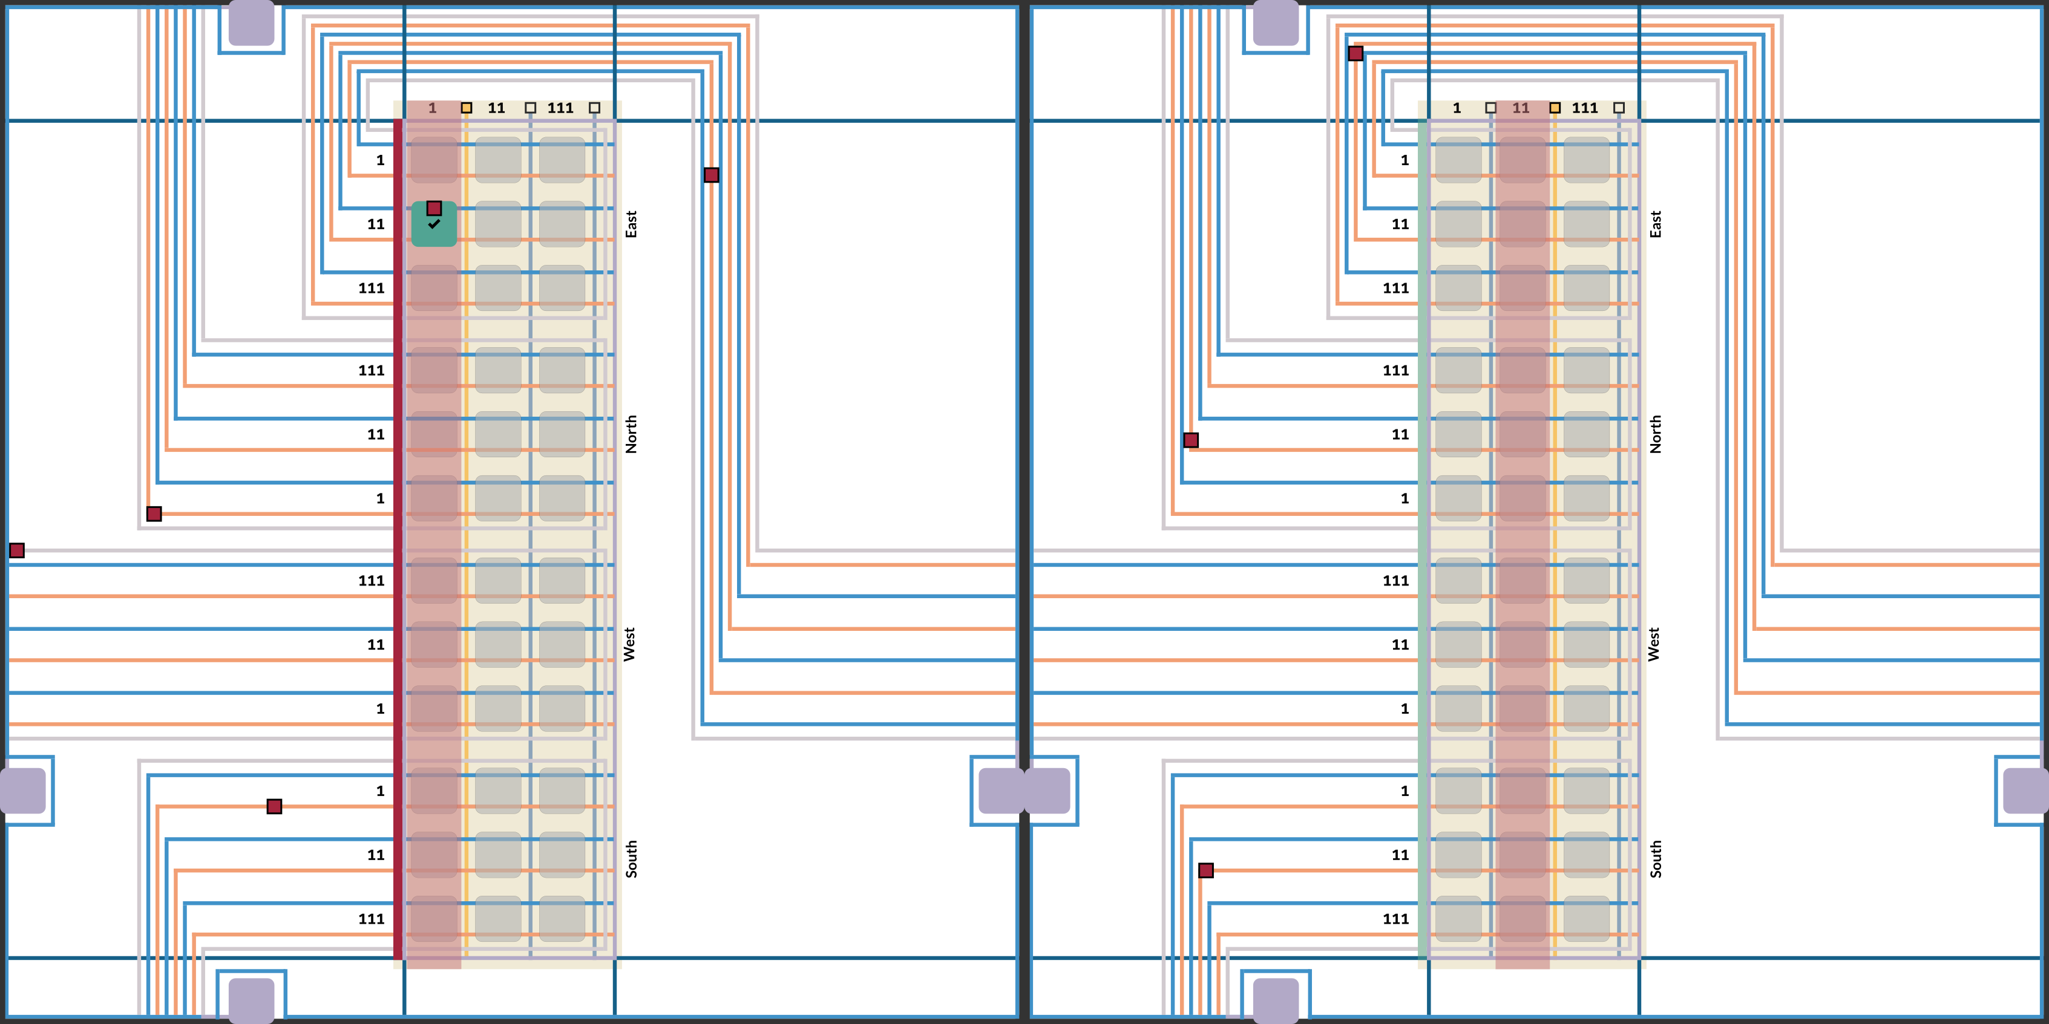
Checking for Available Transition

Slide 23
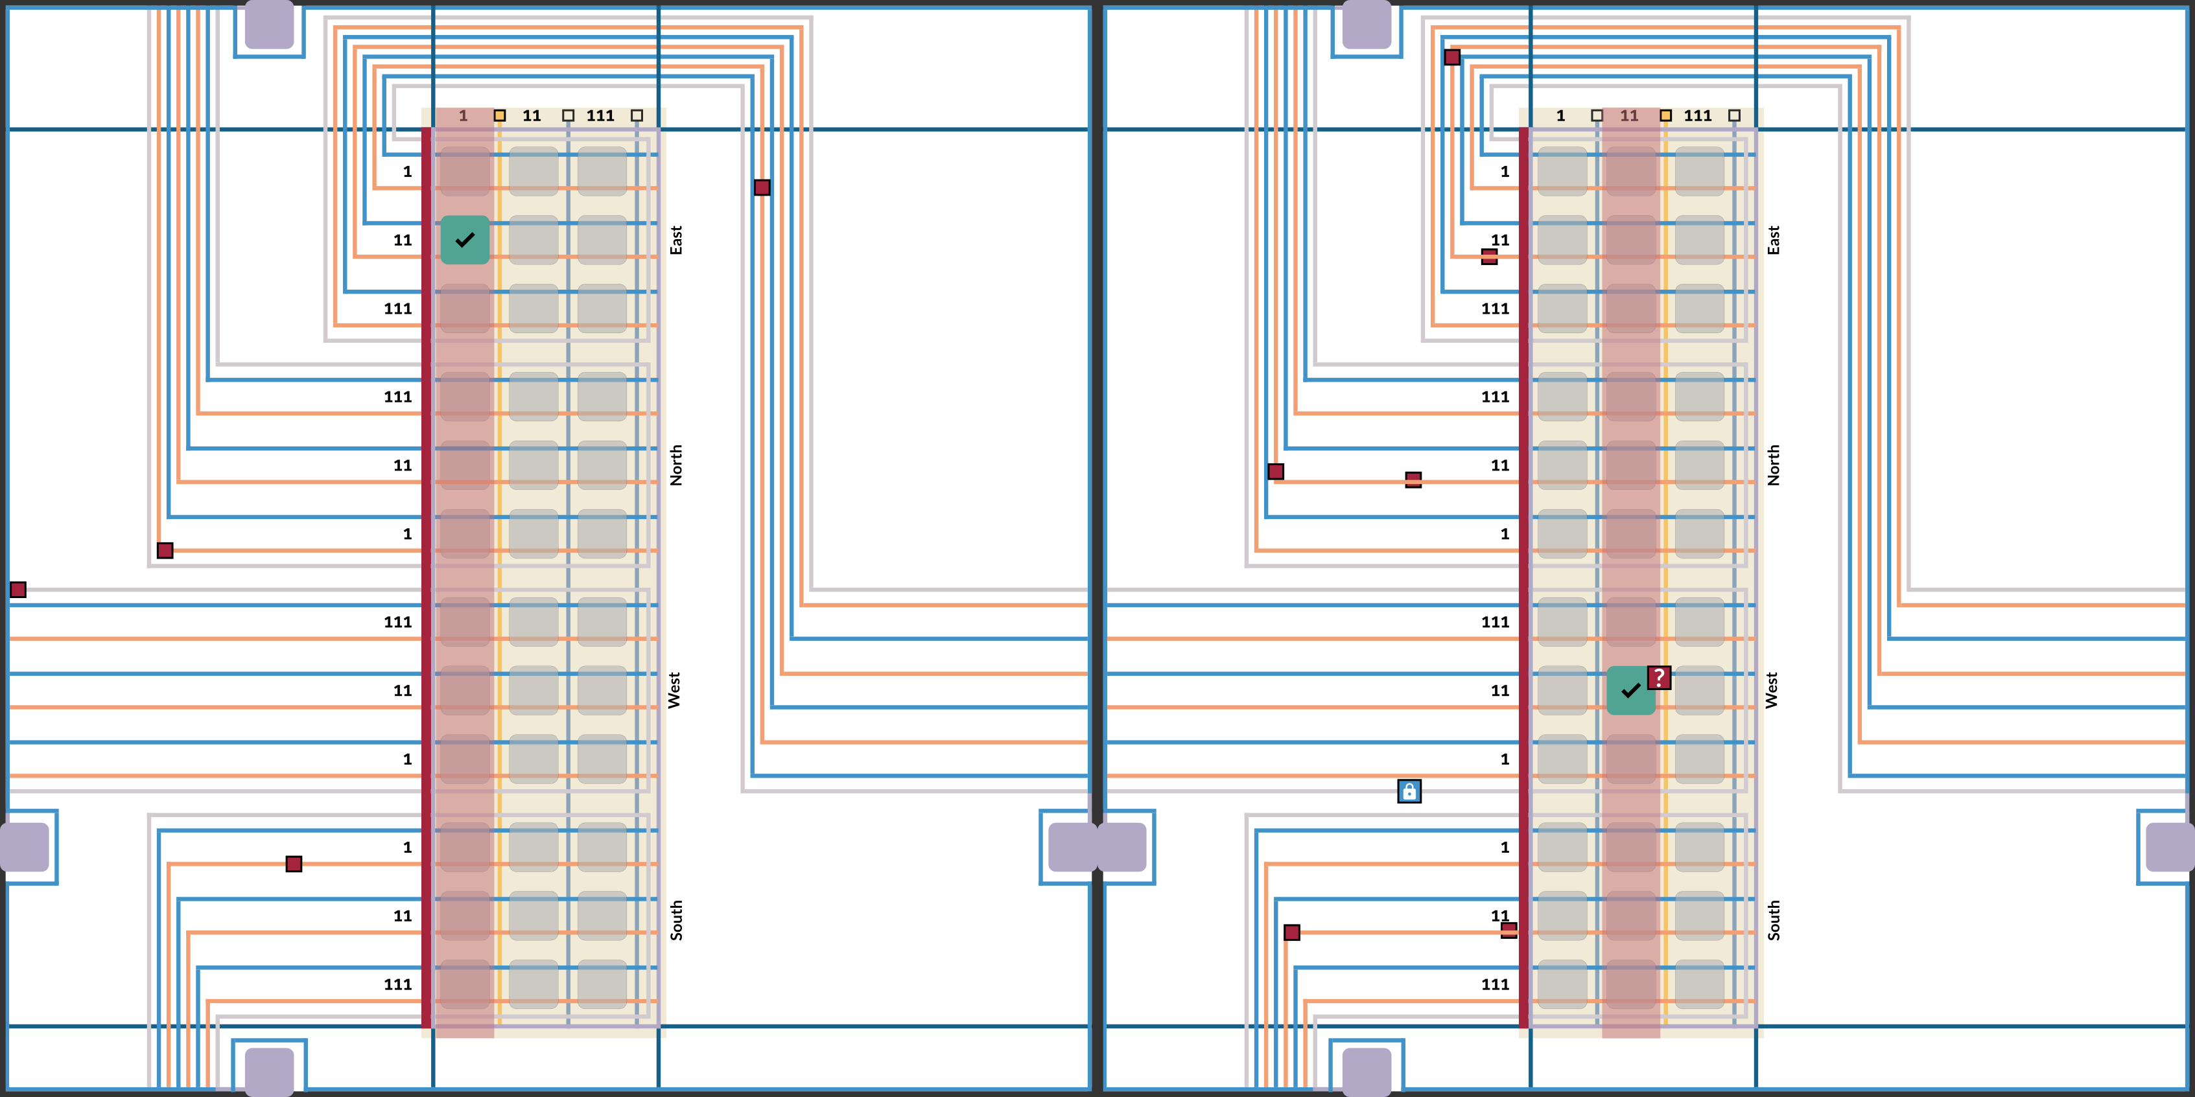
Confirming Neighbors State

Slide 24
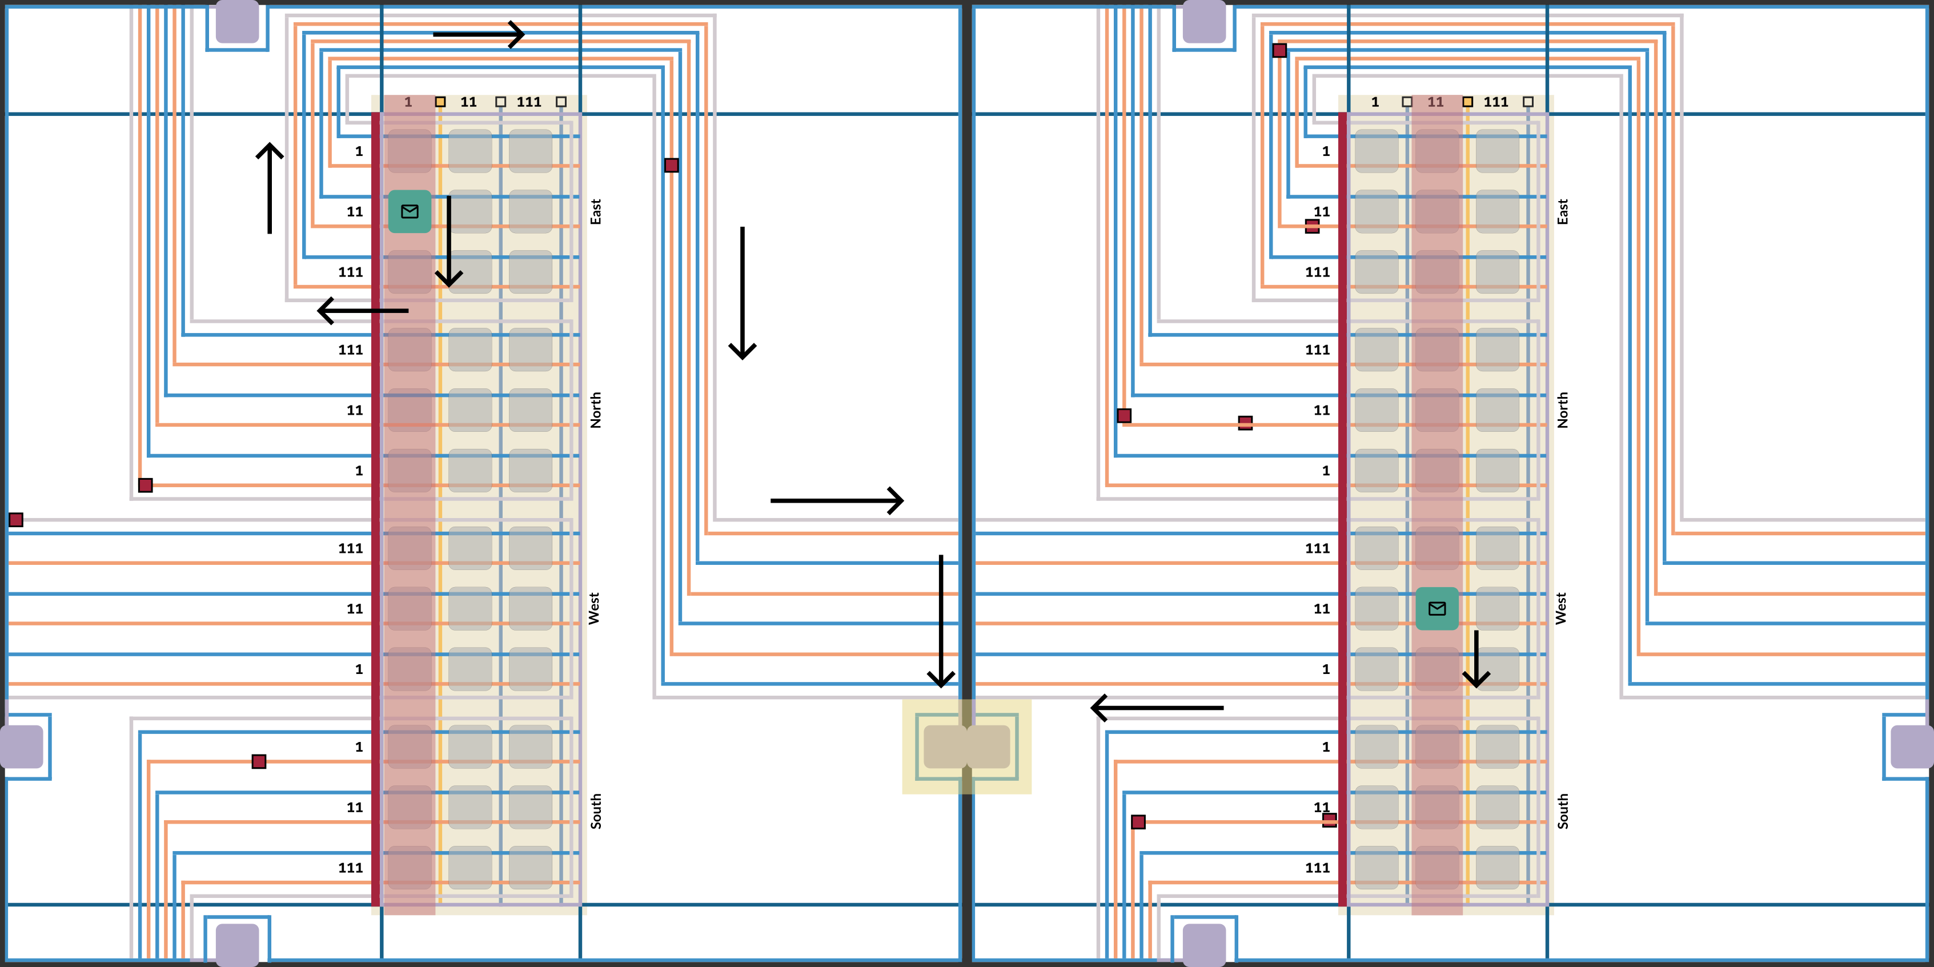
Sending Transition Rule Data Strings

Slide 25
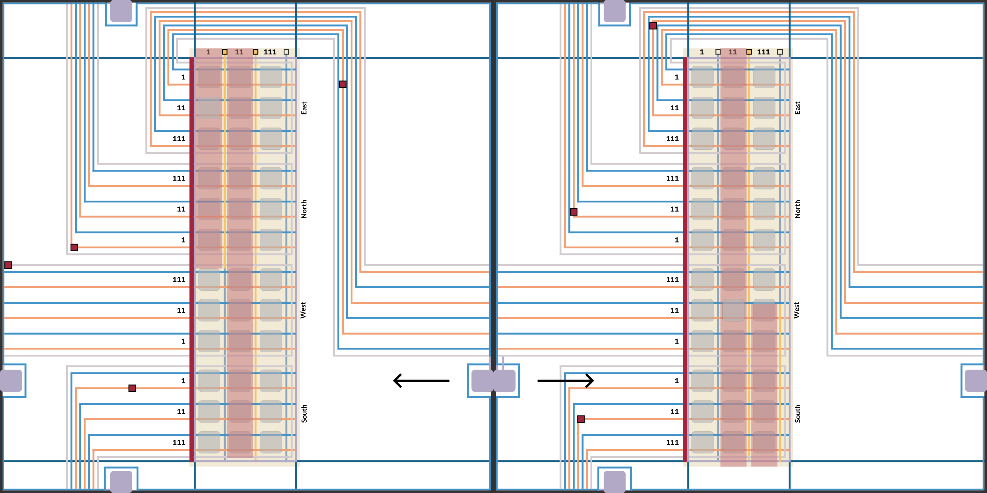
Selecting and Deselecting Columns

Slide 26
Intrinsic Universality in Seeded Active Tile Self-Assembly
Timothy Gomez², Elise Grizzell¹, Asher Haun¹, Ryan Knobel¹, Tom Peters³, Robert Schweller¹, Tim Wylie¹
1 University of Texas Rio Grande Valley, 2 Massachusetts Institute of Technology, 3 TU Eindoven
Notes:
In the main result of my thesis focuses on the creation of a Universal Tile Set in the Seeded Tile Automata model

